Slide 1

Welcome to Amazon Web Services
Presented By :-
Mr. Suryadev Chaudhary

Slide 2
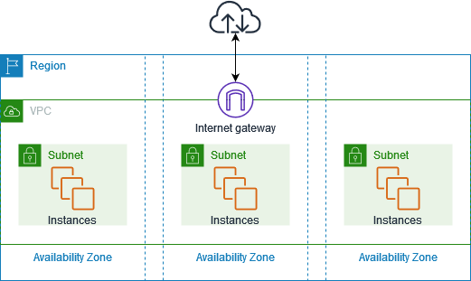
Amazon Virtual Private Cloud (VPC)

Slide 3
Components of VPC
Virtual Private Cloud (VPC)
Subnets
Route Table
Internet Gateway
NAT Gateway
VPC Peering
VPC Endpoints
NACL
Security Group

Slide 4
1.Virtual Private cloud (VPC)
A VPC is a virtual network.
A VPC is a data center inside AWS for one client.
Maximum five (5) VPC can be created in one AWS account.
Maximum 200 subnets can be created in one VPC.
We can allocate maximum five (5) Elastic Ips.
Once we created VPC, by default DHCP,NACL and Security Group will be automatically created.
A VPC is confined to an AWS region

Slide 5
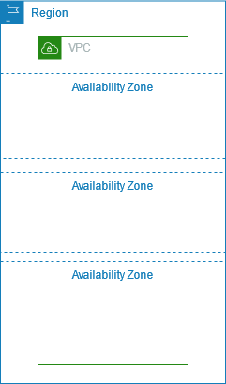
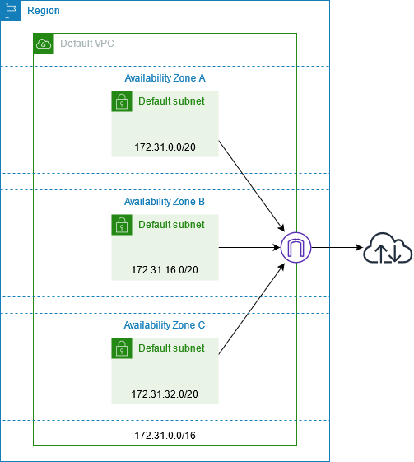
Diagram of VPC Basics

Slide 6
2.Subnets
1.Public Subnet :
A subnet has a route to the internet gateway.
A subnet must have public IPv4 address to connect to the internet.
2. Private Subnet :
A subnet does not have a route to the internet gateway.
We can disable public IPv4 address whenever launch instances in private subnet for safety.
Private Subnet use Elastic IPv4 address with the help of NAT Gateway whenever required.

Slide 7
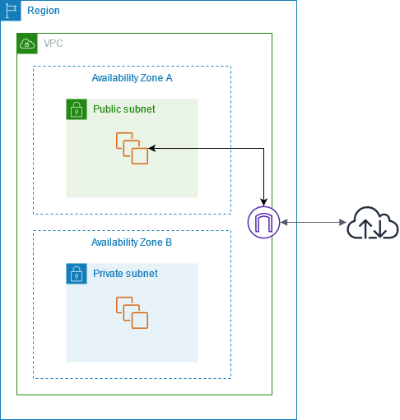
Diagram of Subnet

Slide 8
3.Implied Router/route table
It has a central routing function.
It connects the different AZs together and connect the VPC to IGW.
Upto 200 route tables per VPC.
Upto 50 route entries per route table.
We can associate multiple subnets in one route table.
Router has private IPv4 address.
Each subnet must be associate with only one route table at a time.

Slide 9
4.Internet gateway (IGW)
An IGW is a virtual gateway that connects a VPC to the internet.
In order to access the internet, IGW plays very important role.
Default VPC is already connected to IGW.
Non-Default VPC must attach to IGW using Route Table.
Supports IPv4 and IPv6 address.

Slide 10
5.NaT Gateway
NAT means Network Address Translation.
Enable instances in private subnet to connects the internet or other AWS services.
NAT Gateway creation and uses are chargeable.
It is associated with AWS Account.
It allocate Elastic IPv4 address which is associated with AWS account .
Data processing And Data transferring also chargeable.
NAT Gateway is always reside in public subnet.
No need to assign public IPv4 address separately to private instances.

Slide 11
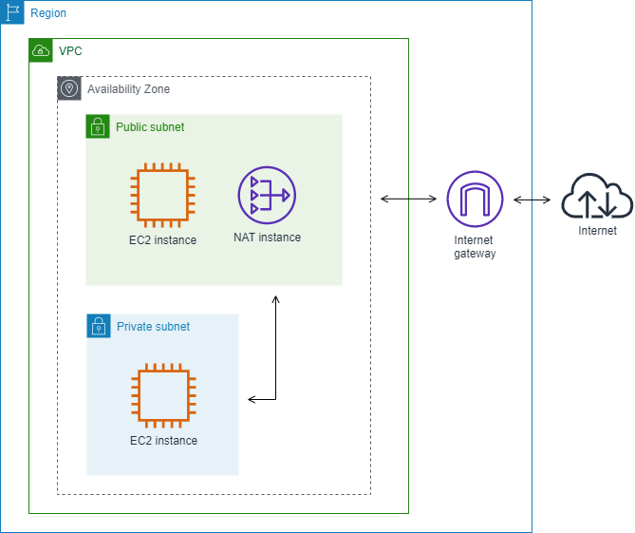
Diagram of IGW & NAT gateway

Slide 12
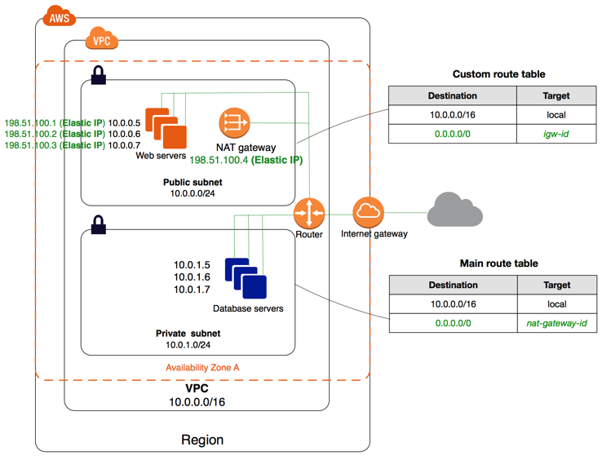
Diagram of IGW,NAT gateway & Router

Slide 13
6.Security group (SG)
SG is virtual firewall works at Elastic Network Interface (ENI) level.
In each EC2 Instance, can upto applied 5 SGs.
SG can only have permit rules.
SG can not have deny rules.
SG allow traffic using port no. and source.
Software
VM
VM
VM
VM
SG
ENI
Virtualization
Virtualization
Hypervisor
Hardware

Slide 14
7.Network Access Control List (nacl)
NACL is applied after implied router.
It is an optional layer of security and act as a firewall.
Controlling inbound and outbound traffic at subnet level.
When we create VPC, by default NACL is created.
In default NACL, it allows inbound and outbound all traffic IPv4.
We can create custom NACL.
In custom NACL, all inbound and outbound traffic is deny until we add the rules
NACL can associate with multiple subnet.
Each subnet must be associate with only one NACL at a time.

Slide 15
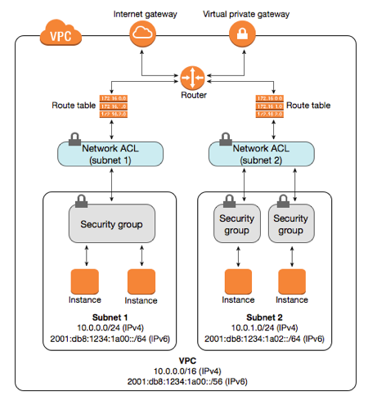
Diagram of NACL

Slide 16
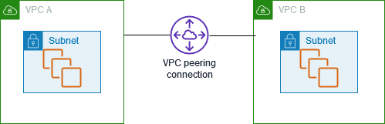
8.VPC Peering
Network connection between two VPCs.
It enables router traffic between two VPCs using private IPv4 address.
Instances in other VPC can communicate with each other.
Can create a VPC peering between own VPC or VPC with other AWS account.
VPC peering enables communication with different region VPC also.

Slide 17
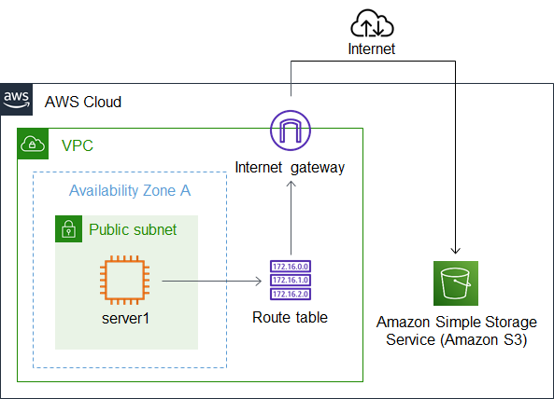
9.VPC endpoint
VPC Endpoint is a virtual device.
VPC endpoint enables to privately connect VPC to supported AWS services.
Instances in private subnet are not required public IPv4 address to communicate with AWS services.

Slide 18
Difference between SG and NACL
SR NO. | SECURITY GROUP | NACL
1. | Operate at instance level | Operate at subnet level
2. | Supports allow rules only | Supports allow as well as deny rules
3. | Stateful | Stateless
4. | Applies to an instance only | Applies to all instances in the subnet

